Slide 1
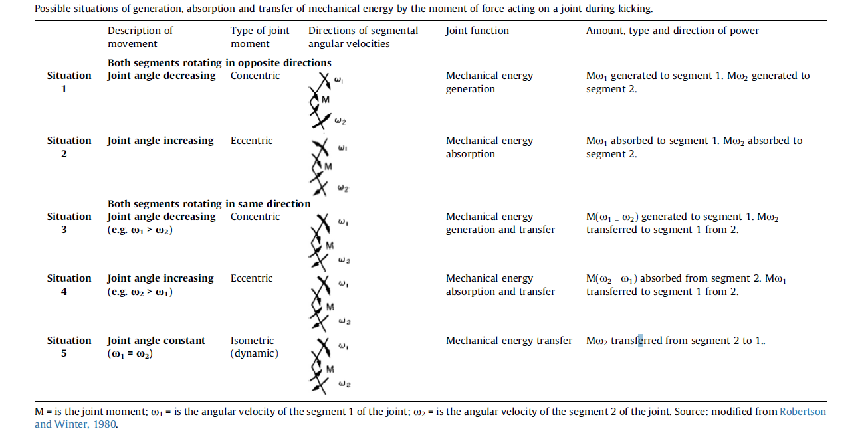
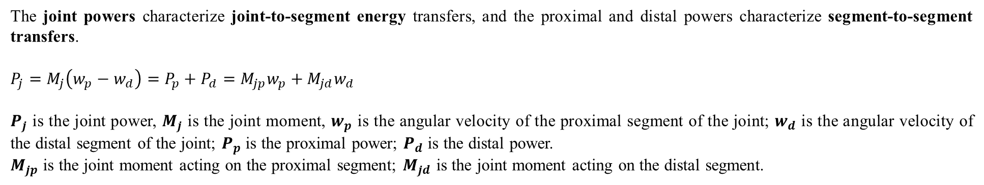
A Brief Overview of the Technique for Illustrating the Mechanism of Energy Transfer
The joint powers characterize joint-to-segment energy transfers, and the proximal and distal powers characterize segment-to-segment transfers.
$$P_{j}=M_{j}\left(w_{p}−w_{d}\right)=P_{p}+P_{d}=M_{jp}w_{p}+M_{jd}w_{d}$$
$P_{j}$ is the joint power, $M_{j}$ is the joint moment, $w_{p}$ is the angular velocity of the proximal segment of the joint; $w_{d}$ is the angular velocity of the distal segment of the joint; $P_{p}$ is the proximal power; $P_{d}$ is the distal power.
$M_{jp}$ is the joint moment acting on the proximal segment; $M_{jd}$ is the joint moment acting on the distal segment.
The directions of the power flows were interpreted in terms of five possible
Situations of transfer:
Ref:
https://www.sciencedirect.com/science/article/pii/S0021929021002050

Slide 2
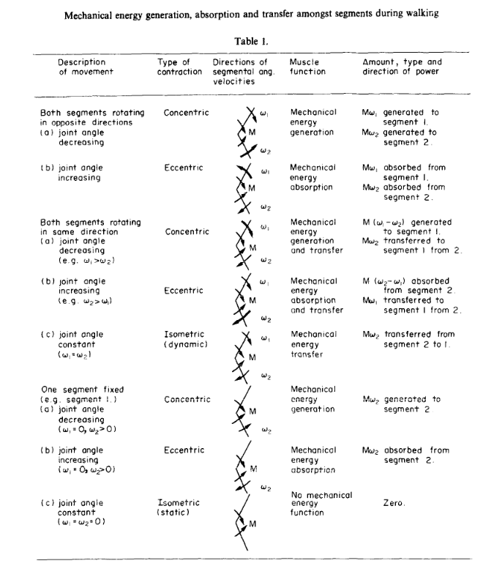
Another reference...
https://www.sciencedirect.com/science/article/pii/0021929080901724
---------------
Sagittal Plane
---------------

Slide 3
The concept of mechanical energy transfer (Power Flow)
Minimizing power at a joint means reducing the risk of injury. [The reason why we used MINIMIZE_POWER for wrist and finger.]
Minimizing power: Using the least amount of energy possible.
“Power is the rate at which work is done, or energy is transferred.“
“Minimize power to prevent injury and distribute the load across larger muscles and tissues. Smaller muscles and tissues are generally more susceptible to injury because they have lower force and torque limits than larger ones.”
$${Joint Mechanical Energy \left(Uj \right)=∫|P}_{j}|dt$$
https://pubmed.ncbi.nlm.nih.gov/11266671/

Slide 4
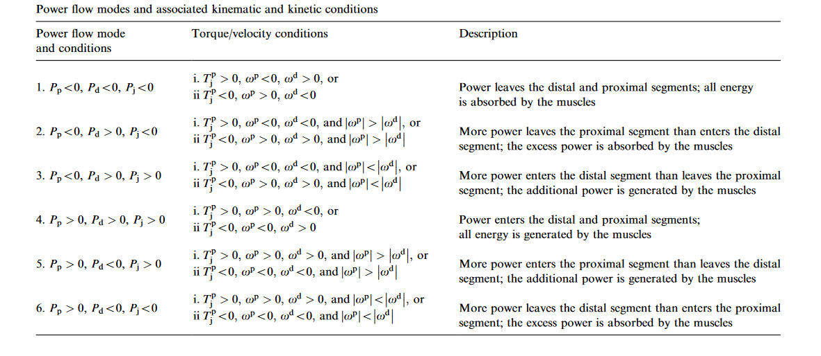
Power flows between the segments can be proximally directed or distally directed, but can only occur when the segments rotate in the same direction. When segments rotate in opposite directions, there is no power flow: energy is entirely absorbed or generated by the muscles.
Another reference...
https://pubmed.ncbi.nlm.nih.gov/11266671/

Slide 5
Prerequisites for interpreting power flow:
1. Joint Moment and Joint Power
2. Segments’ Angular Velocity (Proximal and Distal)
3. Scenario: Simplest Version (Refer to Page 1 or 2).
Suggestions:
3.1. Consider the power flow in the sagittal plane.
3.2. Total Mechanical Energy Expenditure (TMEE) is not needed in this step.

